Slide 1
Chapter 3
Retailing In Electronic Commerce: Products and Services

Slide 2
Learning Objectives
Describe electronic retailing (e-tailing) and its characteristics.
Classify the primary e-tailing business models.
Describe how online travel and tourism services operate and their impact on the industry.
Discuss the online employment market, including its participants, benefits, and limitations.
Describe online real estate services.
Discuss online stock-trading services.

Slide 3
Learning Objectives
Discuss cyberbanking and online personal finance.
Describe on-demand delivery of groceries and similar perishable products and services related to them.
Describe the delivery of digital products and online entertainment.
Discuss various online consumer aids, including comparison-shopping aids.
Describe disintermediation and other B2C strategic issues.

Slide 4
Internet Marketing and B2C Electronic Retailing
electronic retailing (e-tailing)
Retailing conducted online, over the Internet
e-tailers
Retailers who sell over the Internet
SIZE AND GROWTH OF THE B2C MARKET
WHAT SELLS WELL ON THE INTERNET
Developments in E-Commerce

Slide 5
Internet Marketing and B2C Electronic Retailing
CHARACTERISTICS AND ADVANTAGES OF SUCCESSFUL E-TAILING
Advantages of E-Tailing

Slide 6
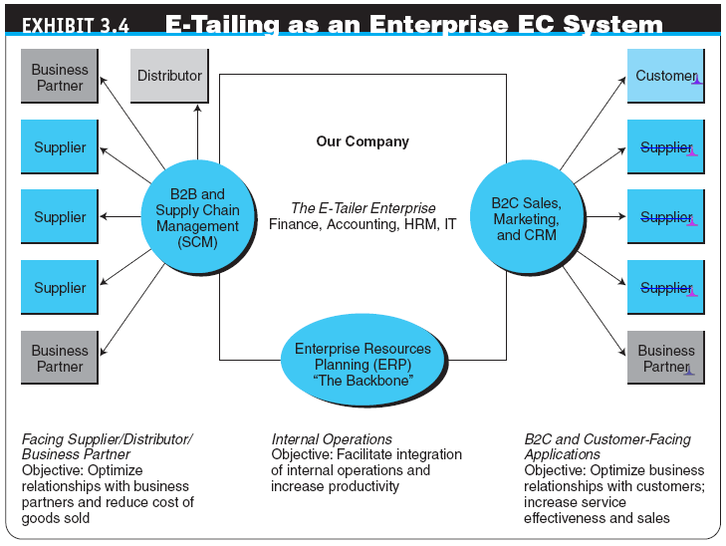

Slide 7
E-Tailing Business Models
CLASSIFICATION OF MODELS BY DISTRIBUTION CHANNEL
Direct marketing by mail-order retailers that go online
Direct marketing by manufacturers
Pure-play e-tailers
Click-and-mortar retailers
multichannel business model
A business model where a company sells in multiple marketing channels simultaneously (e.g., both physical and online stores)
Internet (online) malls

Slide 8
E-Tailing Business Models
direct marketing
Broadly, marketing that takes place without intermediaries between manufacturers and buyers; in the context of this book, marketing done online between any seller and buyer

Slide 9
E-Tailing Business Models
Direct Sales by Manufacturers
virtual (pure-play) e-tailers
Firms that sell directly to consumers over the Internet without maintaining a physical sales channel
click-and-mortar retailers
Brick-and-mortar retailers that offer a transactional website from which to conduct business
brick-and-mortar retailers
Retailers who do business in the non-Internet, physical world in traditional brick-and-mortar stores

Slide 10
E-Tailing Business Models
Retailing in Online Malls
Referring Directories
Malls with Shared Services

Slide 11
E-Tailing Business Models
OTHER B2C MODELS AND SPECIAL RETAILING
B2C SOCIAL SHOPPING
Online Group Buying
Personalized Event Shopping
event shopping
A B2C model in which sales are done to meet the needs of special events (e.g., a wedding, Black Friday).
private shopping club
A members-only shopping club, where members can buy goods at large discounts

Slide 12
E-Tailing Business Models
Group Gifting Online
location-based e-commerce (l-commerce)
Delivery of e-commerce transactions to individuals in a specific location, at a specific time
Shopping in Virtual Worlds
VIRTUAL VISUAL SHOPPING

Slide 13
Travel And Tourism (Hospitality) Services Online
SERVICES PROVIDED
SPECIAL SERVICES ONLINE
Wireless services
Advanced check-in
Direct marketing
Alliances and consortia
Social Travel Networks
BENEFITS AND LIMITATIONS OF ONLINE TRAVEL SERVICES
CORPORATE TRAVEL

Slide 14
Employment Placement and the Job Market Online
PARTIES WHO USE THE INTERNET JOB MARKET
Job seekers
Employers seeking employees
Classified ads
Job agencies
Government agencies and institutions
Online Job Markets on Social Networks
Global Online Portals for Job Placement
Virtual Job Fairs

Slide 15
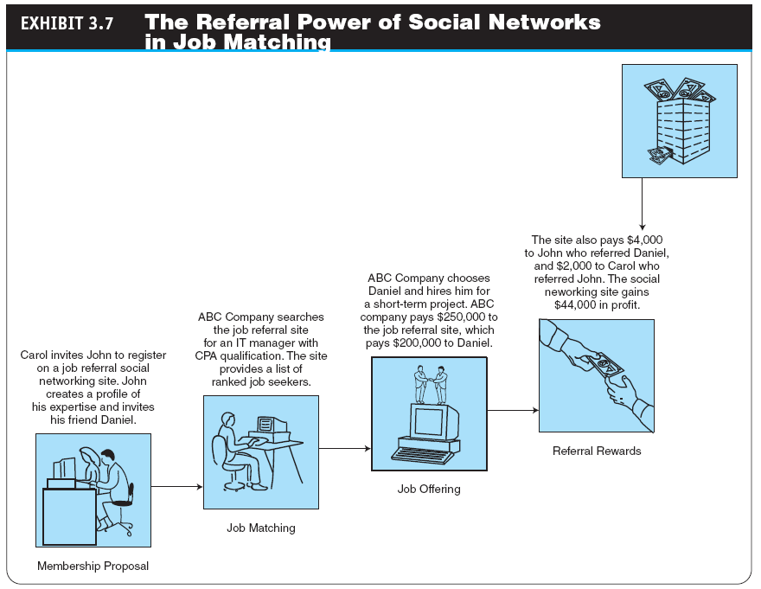
Notes:
Referral: giới thiệu

Slide 16
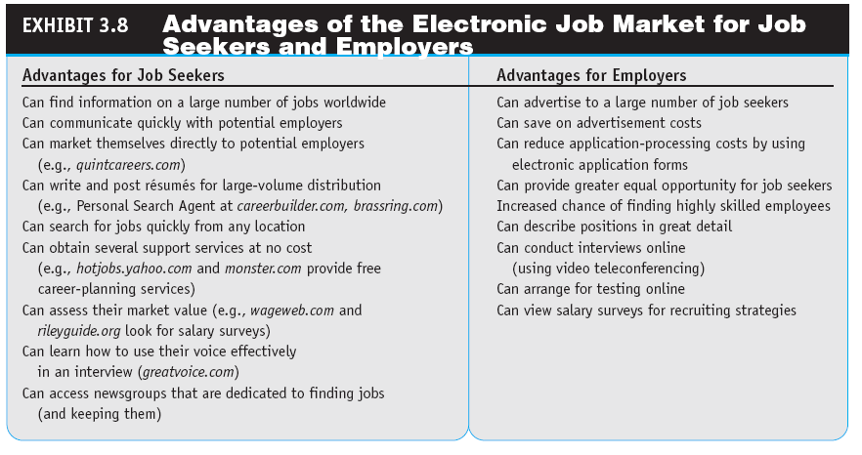

Slide 17
Real Estate, Insurance, and Stock Trading Online
REAL ESTATE ONLINE
Zillow, Craigslist, and Other Web 2.0 Real Estate Services
INSURANCE ONLINE
ONLINE STOCK TRADING
The Risk of Trading in an Online Stock Account

Slide 18
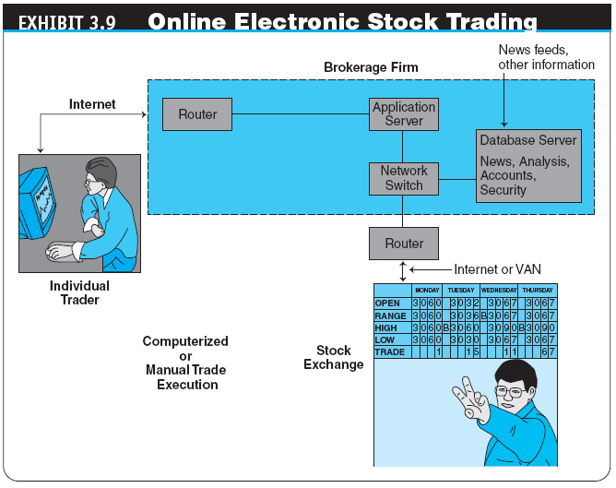

Slide 19
Banking and Personal Finance Online
electronic (online) banking or e-banking
Various banking activities conducted from home or the road using an Internet connection; also known as cyberbanking, virtual banking, online banking, and home banking

Slide 20
Banking and Personal Finance Online
HOME BANKING CAPABILITIES
VIRTUAL BANKS
INTERNATIONAL AND MULTIPLE-CURRENCY BANKING

Slide 21
Banking and Personal Finance Online
ONLINE FINANCIAL TRANSACTION IMPLEMENTATION ISSUES
Securing Financial Transactions
Imaging Systems
Fees Online Versus Fees for Offline Services
Risks
ONLINE BILLING AND BILL PAYING
Taxes

Slide 22
On-Demand Delivery of Products, Digital Items, Entertainment, and Gaming
ON-DEMAND DELIVERY OF PRODUCTS
e-grocer
A grocer that takes orders online and provides deliveries on a daily or other regular schedule or within a very short period of time
on-demand delivery service
Express delivery made fairly quickly after an online order is received

Slide 23
On-Demand Delivery of Products, Digital Items, Entertainment, and Gaming
ONLINE DELIVERY OF DIGITAL PRODUCTS, ENTERTAINMENT, AND MEDIA
ONLINE ENTERTAINMENT
Adult Entertainment
Internet Gaming
Online Dating Services

Slide 24
Online Purchasing-Decision Aids
shopping portals
Gateways to webstores and e-malls; may be comprehensive or niche oriented
Helping Communities

Slide 25
Online Purchasing-Decision Aids
PRICE AND QUALITY COMPARISON BY SHOPBOT SOFTWARE AGENTS
shopping robots (shopping agents or shopbots)
Tools that scout the Web on behalf of consumers who specify search criteria
Google Commerce Search 2.0
“Spy” Services
Wireless Shopping Comparisons

Slide 26
Online Purchasing-Decision Aids
BUSINESS RATINGS SITES
Recommendations from Other Shoppers and Friends
referral economy
The effect upon sales of consumers receiving a referral or recommendation from other consumers.
TRUST VERIFICATION SITES
OTHER SHOPPING TOOLS
Yelp

Slide 27
Issues In E-Tailing and Lessons Learned
disintermediation
The removal of organizations or business process layers responsible for certain intermediary steps in a given supply chain
reintermediation
The process whereby intermediaries (either new ones or those that had been disintermediated) take on new intermediary roles

Slide 28
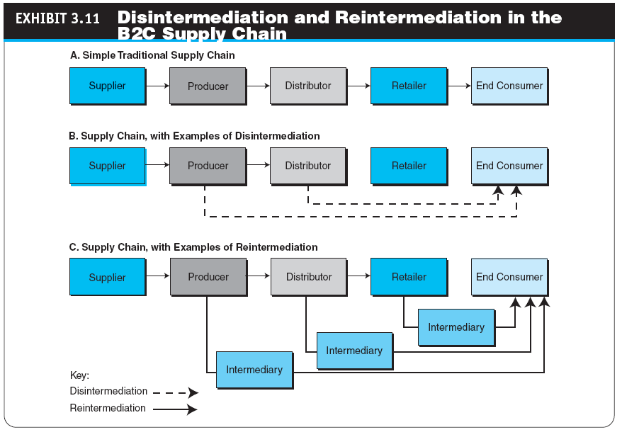

Slide 29
Issues In E-Tailing and Lessons Learned
channel conflict
Situation in which an online marketing channel upsets the traditional channels due to real or perceived damage from competition

Slide 30
Issues In E-Tailing and Lessons Learned
POSSIBILITY OF A PRICE CONFLICT AND DETERMINING THE RIGHT PRICE BY SELLERS
PRODUCT AND SERVICE CUSTOMIZATION AND PERSONALIZATION
ONLINE COMPETITION
FRAUD AND OTHER ILLEGAL ACTIVITIES

Slide 31
Issues In E-Tailing and Lessons Learned
LESSONS LEARNED FROM FAILURES AND LACK OF SUCCESS OF E-TAILERS
Speak with one voice
Leverage the multichannels
Empower the customer

Slide 32
Managerial Issues
What are the limitations of e-tailing? Where is e-tailing going?
How should we introduce wireless shopping?
Do we have ethics and privacy guidelines?
How will intermediaries act in cyberspace?
Should we try to capitalize on social networks?
How should we manage multichannel marketing to avoid channel and/or price conflicts?
What are the major potential limitations of the growth of B2C EC?

Slide 33
Summary
The scope and characteristics of e-tailing
Classify e-tailing business models
How online travel/tourism services operate
The online job market and its benefits
The electronic real estate marketplace
Online trading of stocks and bonds

Slide 34
Summary
Cyberbanking and personal finance
On-demand delivery service
Delivery of digital products
Aiding consumer purchase decisions
Disintermediation and other B2C strategic issues

Slide 35
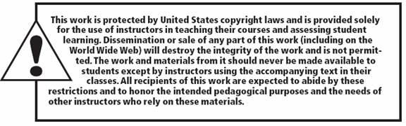
All rights reserved. No part of this publication may be reproduced, stored in a retrieval system, or transmitted, in any form or by any means, electronic, mechanical, photocopying, recording, or otherwise, without the prior written permission of the publisher. Printed in the United States of America.
Copyright © 2012 Pearson Education, Inc.
Publishing as Prentice Hall

